Slide 1
Masterclass 'Energiemarkten' Gasmarkten en ETS
COGEN @ ELIA 13 November 2025

Slide 2








PowerPulse – 3 integrated service delivery axes
Energy management
Define best energy contract framework for customer footprint & operations
Implement purchasing and risk management strategy
Provide reporting, control invoices, monitor budgets and track energy performance
Founded in 2014
Team of 19 experts
2
Projects & Asset steering
Serving over 200 clients
Saving +150k tons/y of CO₂
Technical: closed distribution systems (CDS), local energy communities
Onsite renewable energy production, energy storage, EV-mobility
Day-ahead and intraday algorithm-based optimization for energy assets (e.g. cogeneration unit heat/steam & power)
3
We guide you through the energy transition
Pathway to a corporate climate strategy
Initiate carbon accounting & set mid/long term climate strategy goals
Assess & implement carbon reduction actions to reach goals
Purchase renewable power (guarantees of origin, on-site, large off-site PPA)

Slide 3
PowerPulse company overview
+20
TWh
Energy flows managed by PowerPulse
6,2
mln
EUR
Annual energy costs saved for clients
516
MW
Flexible capacity optimized
+100K
tons
CO₂
Amount of CO₂ saved per year
12
FTE
Team of energy experts

Slide 4























Production site of the future
Site of the future
Context: Markets and regulation
Processes
Heat production
Other electrical equipment
Volatile markets (many low prices)
Peak monitoring
Gas boiler in ETS / ETS 2
EV / Truck charging
Tighter ETS and launch of ETS-2
Load shifting
E-Boiler
Solar PV and curtailment
Strong renewable build-up
Demand forecasting
Industrial heat pump
Battery system
Sustainability targets
Energy management
2050
Hedging and risk strategy
Supply and flexibility contracts
Flemish PV obligation
Renewable PPA contract
Energy management system (EMS)
Power to natural gas tax shift
Emerging technologies such as
CCS, low-carbon hydrogen, biomethane, geothermal, solar CSP, … may also play a role in the longer term
Context:
Grid infrastructure
Connection constraints
System flexibility needs
Grid investments
Time of use tariffs
Slide intended for illustrative purpose
Not every asset or activity is feasible or profitable for all companies

Slide 5
Recent trends in the Gas market
Heading into winter 2025/2026
Long term outlook
ETS 1 & 2

Slide 6

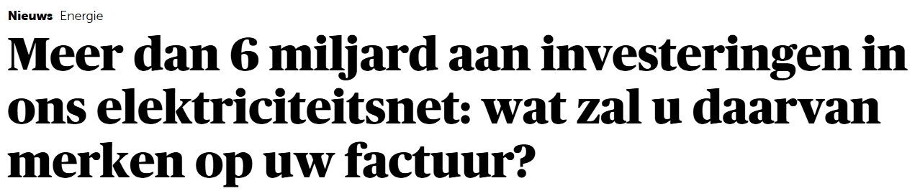
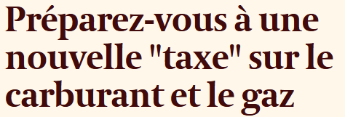

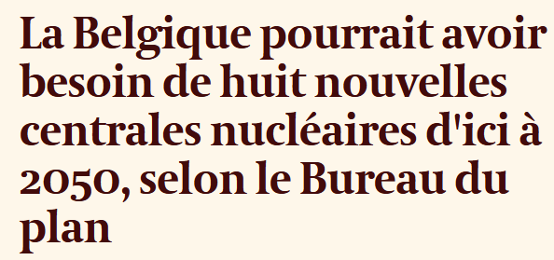

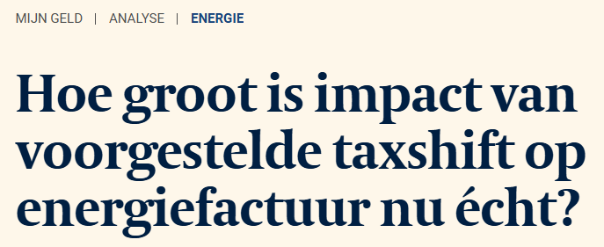
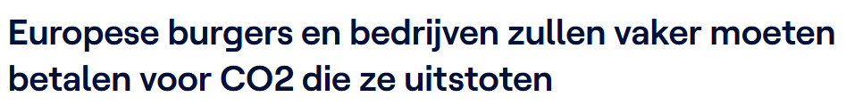
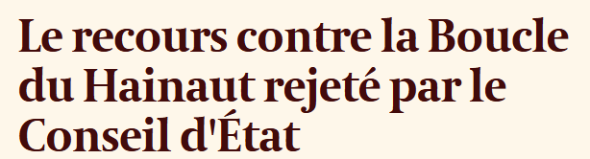
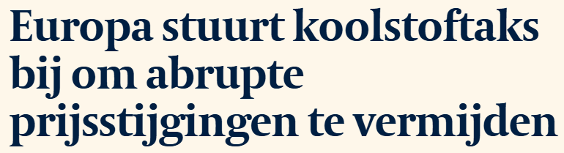
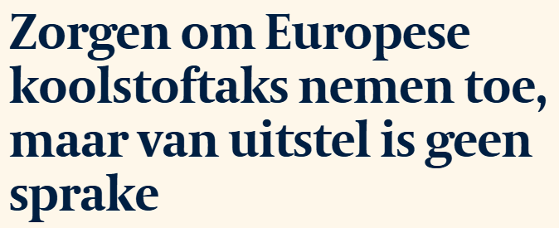
Recent headlines in the news

Slide 7
Volatility indicator of selected commodities during 2025
% Volatility indicator; 25-day Standard deviation divided by 25-day moving average; Average of 1 Jan – 5 Nov 2025
CAL+1 prices for Oil, CO2, Coal, BE power and TTF gas; Spot for Bitcoin and Gold; Daily index settlement for Dow Jones Index
Index

Slide 8
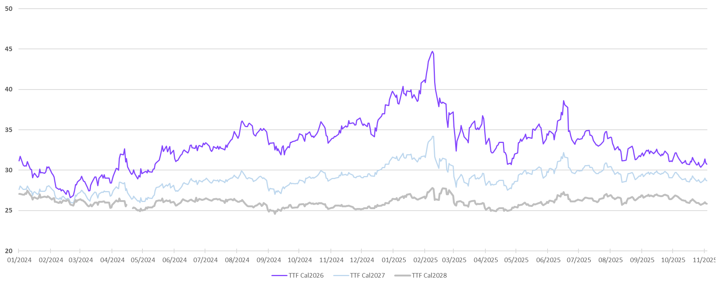
Gas price evolutions
EUR per MWh; daily prices of TTF gas for CAL26, CAL27 and CAL28

Slide 9
Monthly spot TTF Gas prices
EUR/MWh; Average prices

Slide 10
TTF gas spot price comparison of last three years
EUR/MWh; Daily TTF natural gas spot prices in 2023, 2024 and 2025 (average 2025 ytd; 37,50 EUR/MWh)

Slide 11
Global gas price benchmark
EUR/MWh; TTF, Henry hub and JKM monthly average spot prices; Prices calculated based on customs data for Asian countries
Note: Custom organizations do not always publish LNG import prices for each month, which explains gaps in the chart

Slide 12
Global gas price benchmark
EUR/MWh; TTF, Henry hub and JKM monthly average spot prices; Prices calculated based on customs data for Asian countries
Note: Custom organizations do not always publish LNG import prices for each month, which explains gaps in the chart

Slide 13
Global gas price benchmark
EUR/MWh; TTF, Henry hub and JKM monthly average spot prices; Prices calculated based on customs data for Asian countries
Note: Custom organizations do not always publish LNG import prices for each month, which explains gaps in the chart

Slide 14
Overview of world’s largest natural gas producers and consumers
BCM; 2024 data; Largest countries producing and consuming natural gas; Includes all countries with at least 50 BCM consumption or production of natural gas
Largest gas producers
Largest gas consumers
Source: Energy Institute data

Slide 15
Largest net exporters of natural gas in 2024
BCM net exports by pipeline and LNG in 2024
Source: Energy Institute data

Slide 16
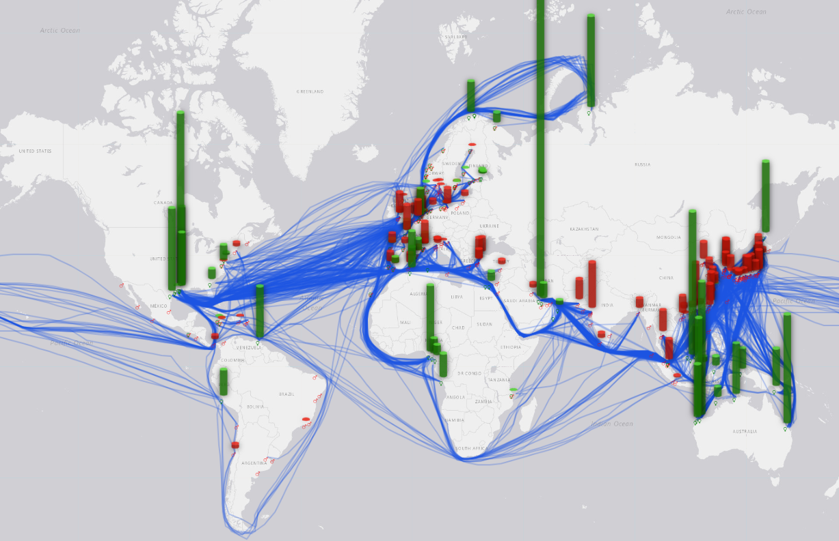
Post-crisis natural gas market
Global LNG market
Dependance on overseas supply and demand
Source: Ifri

Slide 17

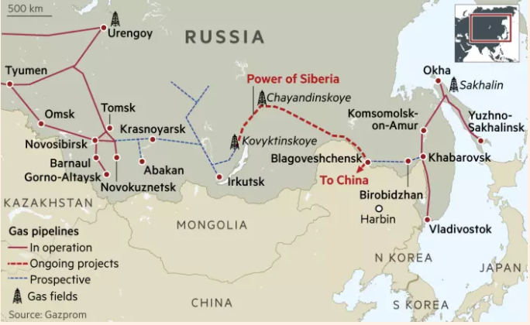
The Power of Siberia project
Overview of the Power of Siberia project
Evolution of flows through Power of Siberia
BCM; Natural gas flows of Power of Siberia; Historical figures for 2020-22; Forecasts for 2023-2025
Power of Siberia pipe sends gas from East Siberian gas fields to China since 2020 (agreement signed in 2014)
West Siberian gas fields (such as Urengoy / Yamal) provide gas which flows to Europe
Gas destined for Europe currently cannot be shipped directly by pipe to China
Potential proposed expansion could add another 7-8 BCM per year
Source: Gazprom, Reuters, SP Global, Center for the study of democracies
Notes:
https://www.spglobal.com/commodityinsights/en/market-insights/latest-news/lng/091323-chinas-cnpc-drives-hard-bargain-for-impending-power-of-siberia-2-gas-deal-with-Russia
Annual gas supply from Power of Siberia 1 is expected to reach 22 Bcm in 2023, 30 Bcm in 2024 and 38 Bcm in 2025, based on the current schedule, up from around 15 Bcm in 2022, according to state media. A proposed expansion could add another 7-8 Bcm/year, while Power of Siberia 2 is expected to reach 50 Bcm/year at full capacity.

Slide 18
Natural gas demand in Western Europe
BCM per week natural gas demand in Germany, Belgium, Netherlands and France
2025 YTD gas demand:
+2,1% versus 2024
(October 2025: +9% vs 2024)

Slide 19
Global PMI evolutions
PMI (Purchase Managers’ Index) monthly averages by S&P
Figures above 50 indicate expansion, figures below 50 indicate contraction
Manufacturing PMIs
Services PMIs
EU manufacturing PMI remained at the 50 threshold, after a long period since mid-2022 with weak manufacturing PMIs
US manufacturing PMIs remained rather stable last month, while Chinese PMI indicators fell back below 50
European and US services PMI continued their positive trend and improved further last month
Chinese services PMI remained stable around the 50 threshold
Source: S&P

Slide 20
Norwegian pipeline gas flows to Europe
BCM/Month; Monthly flows from Norway to Europe
Conclusions:
October flows were just below last year’s levels
Moderate impact by seasonal maintenance activities, which did not face significant delays or issues this year
2025 YTD flows from Norway are roughly 3 BCM lower than last year
Norwegian flows in 2024 were 109 BCM

Slide 21
Global LNG gas supply is reaching record high levels
BCM; Monthly LNG supply globally
Conclusions:
YTD 2025 global LNG flows increased by about 20 BCM vs 2024 (+4%)
Mainly driven by additional LNG from the United States where new projects have been commissioned (e.g. Plaquemines LNG)
October flows from Nigeria and Algeria were also well above las month’s level

Slide 22

European LNG import levels in recent years
BCM per week of natural gas; EU and UK; Send-out volumes of European LNG terminals on weekly basis; Data from ALSI
Conclusions:
October 2025 LNG imports increased further compared to last month and last year. Flows were 1,6 BCM higher than in September
Imports totaled 12,7 BCM in September, this is 4,0 BCM higher than in 2024 (+44%)
LNG import levels in Jan-Oct 2025 were 29% above 2024 levels (+27 BCM)
Source: Gas infrastructure Europe

Slide 23
Annualized LNG import volumes on monthly basis by country
BCM annualized LNG import volumes on monthly basis; Each month mentions the sum of the previous 12 months LNG imports
Conclusions:
China is still the world’s largest LNG importer, though the gap with Japan is getting smaller
Chinese demand is now showing a declining trend after two years of increasing LNG imports
Source: Customs departments of China, Japan, South Korea, India and Taiwan

Slide 24
Supply mix of Chinese natural gas
BCM/y; Rolling annualized volume trends of gas production and supply for China
Source: Chinese customs, Chinese statistical office, Energy Institute, Refinitiv
Notes:
(Compound annual growth rate)
The Chinese are very price sensitive and will switch fuels depending on the current market conditions.
Strong domestic prod increase and pipeline imports. LNG imports cyclical.

Slide 25
Recent trends in the Gas market
Heading into winter 2025/2026
Long term outlook
ETS 1 & 2

Slide 26
Weekly nuclear availabilities for 2026
MW available nuclear capacity; Remit production outages as of 1 Sep 2025 (can be updated with additional outages later on)
Taking into account current nuclear decommissioning law of Belgium, also for lifetime extension units Doel 4 and Tihange 3
Source: Elia, Remit, Belgian government

Slide 27
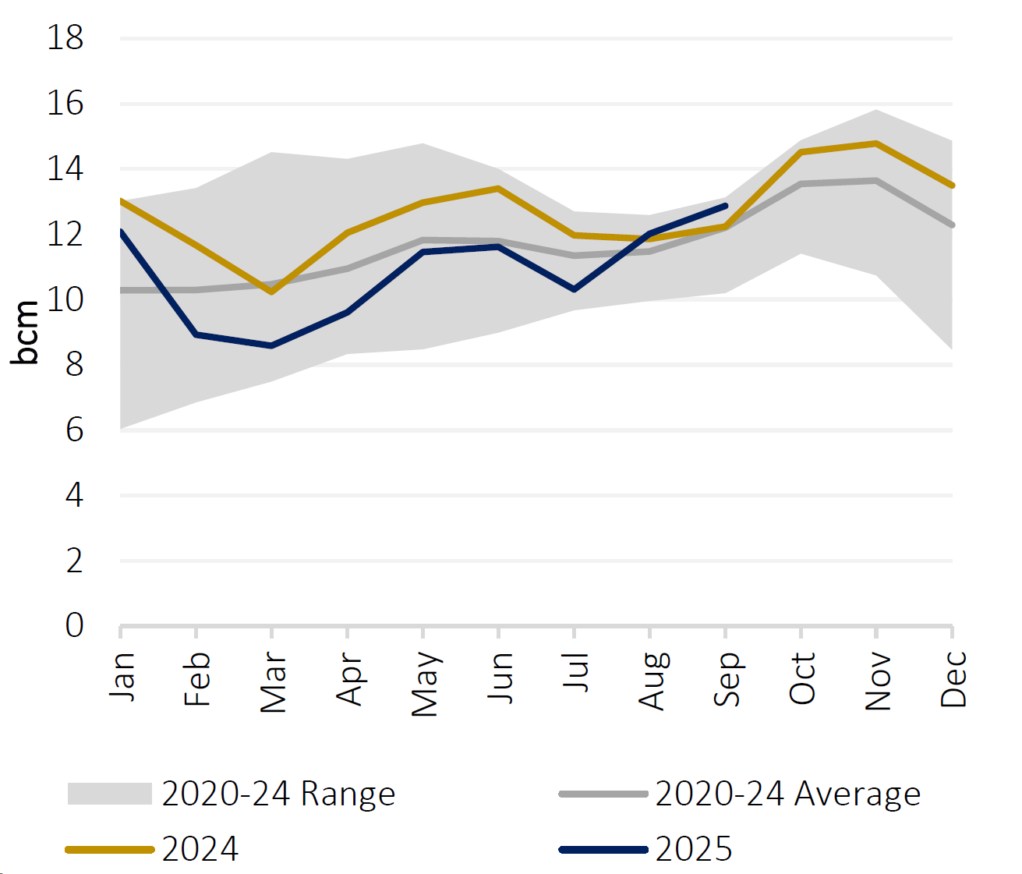
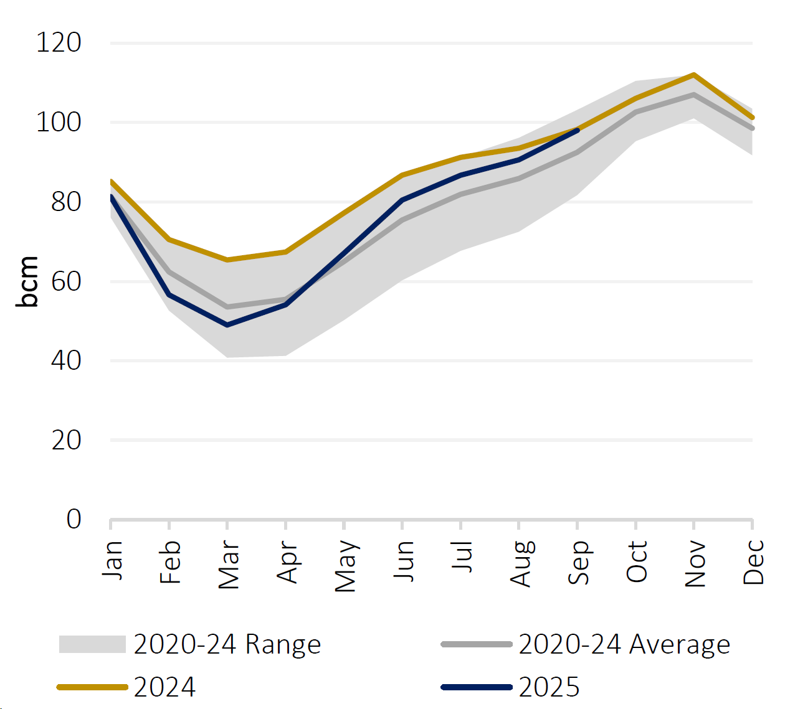
Storage levels in Asia and the United States
Storage levels in Japan and South Korea
Storage levels in the United States
Source: GECF Secretariat based on data from LSEG and US EIA

Slide 28
European gas storage rates with EU targets
%; Storage filled up as % of maximum storage level in Europe

Slide 29
European gas storage rates with EU targets
%; Storage filled up as % of maximum storage level in Europe
Filling trajectory minimum target by
01/02/2025: 45%
01/05/2025: 30%
01/07/2025: 50%
01/09/2025: 70%*
Target at 80%-90% between 1st of October and 1st of december (to be confirmed by EU legislation)
Margin of 5% applicable, the level at the end of January is ideally close to 55% if the temperature is not colder than average.
Target Germany: 45% - 10% - 30% - 65% - 90%
*rounded up based on average figures of all EU countries.
Source: European Union EUR-Lex
90% (anytime in Oct-Nov)
70%
50%
45%
30%

Slide 30
Weekly volumes of storage injections / withdrawals
TWh; Weekly storage injections (positive numbers) and withdrawals (negative numbers) in the EU
Conclusions:
Injection into storages in October was consistently lower than 5-year average
During the last weeks, storage levels were stable, fluctuating around 83%
The 90% EU target will not be met this year
Storage levels as of end October were still 12% below 2024
Source: GIE AGSI

Slide 31
Recent trends in the energy markets
Heading into winter 2025/2026
Long term outlook
ETS 1 & ETS 2

Slide 32
International comparison of natural gas forward curves
EUR/MWh; Monthly TTF, Henry Hub and JKM natural gas futures price; Prices and EUR/USD rate of 1 Nov 2025
Source: ICE, CME

Slide 33
International comparison of natural gas forward curves
EUR/MWh; Monthly TTF, Henry Hub and JKM natural gas futures price; Prices and EUR/USD rate of 1 Nov 2025
Source: ICE, CME

Slide 34
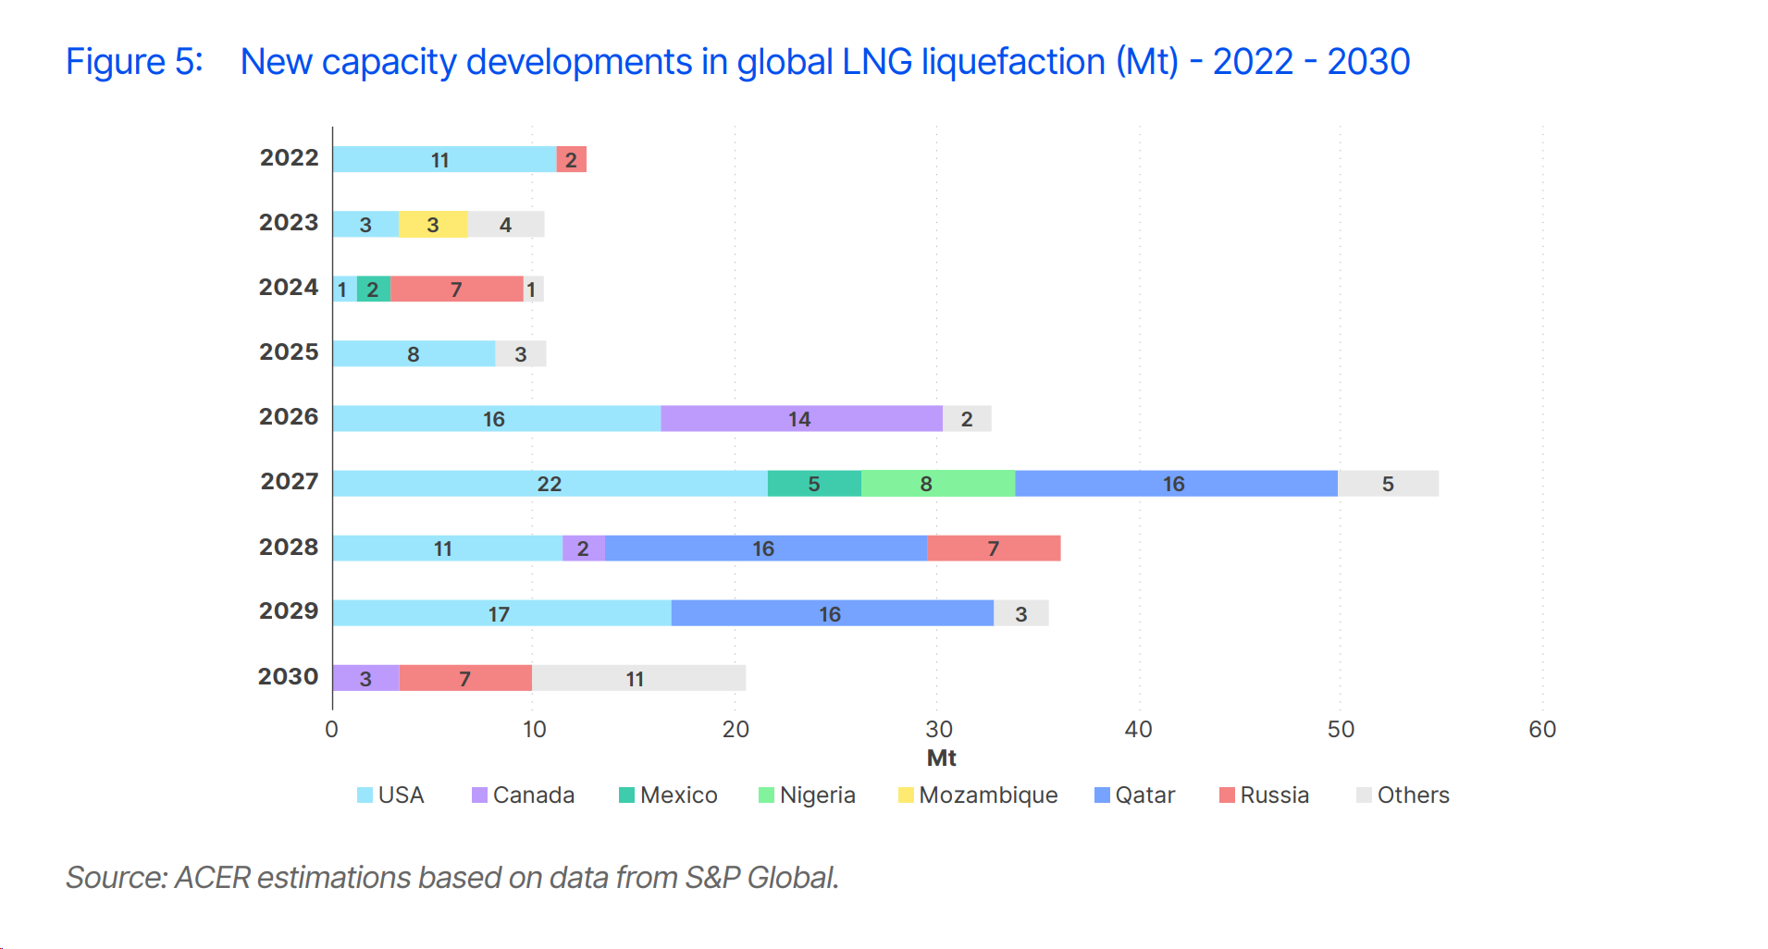
ACER outlook for new LNG supply capacity
15
45
79
Total of 254 BCM new LNG capacities expected to come online between 2026-30
51
50
29
Source: ACER 2025 analysis

Slide 35
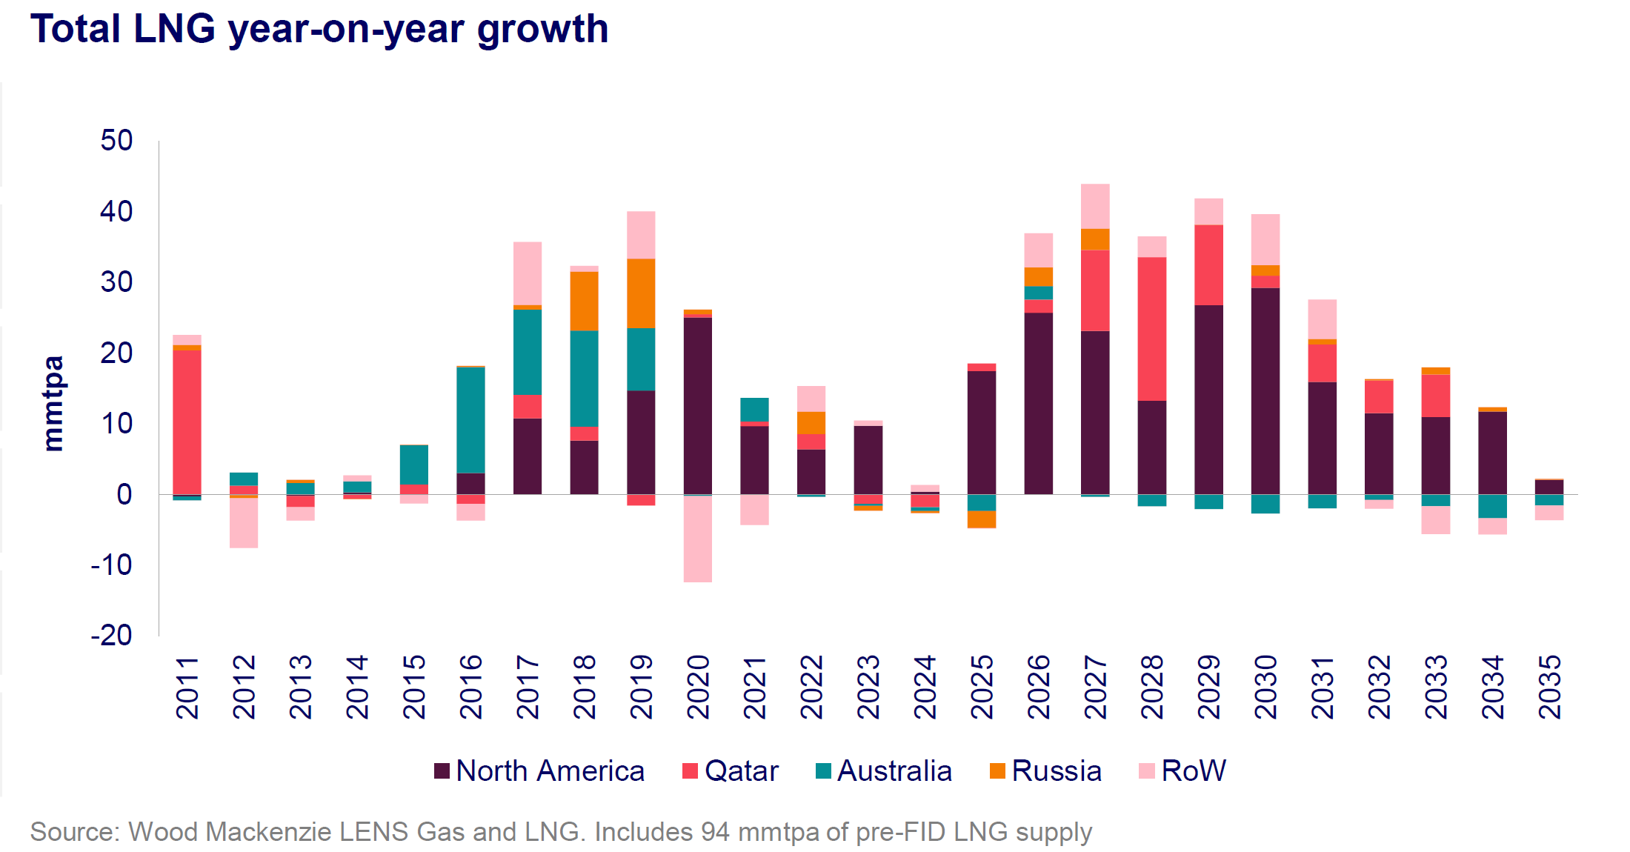
Long and strong wave of new LNG export additions expected by WoodMackenzie
Source: WoodMackenzie 2025 analysis

Slide 36
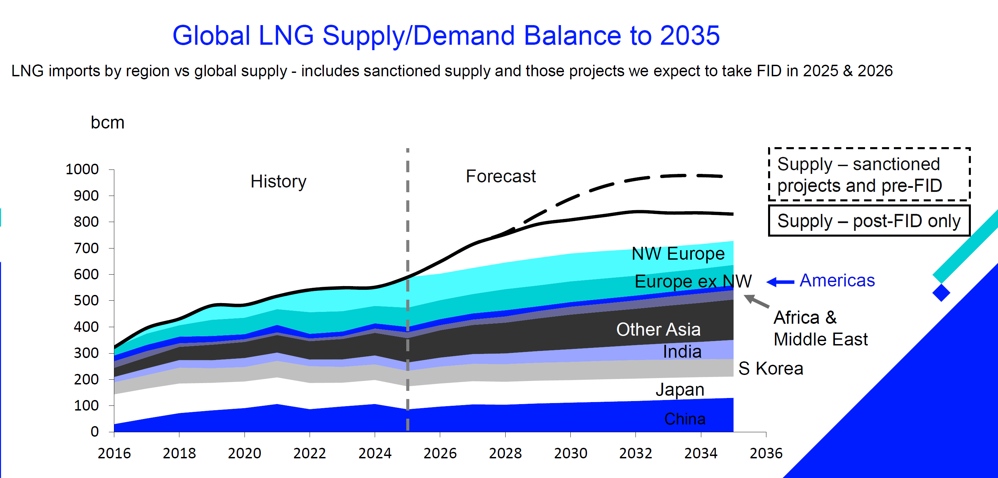
Oversupplied global LNG market projected by Refinitiv/LSEG
Refinitiv/LSEG expects a loose LNG market from 2026-27 onwards thanks to higher LNG supply (higher oversupply vs similar analysis in 2024)
Demand could be covered by FID projects according to this analysis
Source: Refinitiv 2025 analysis, part of LSEG (London Stock Exchange Group)

Slide 37
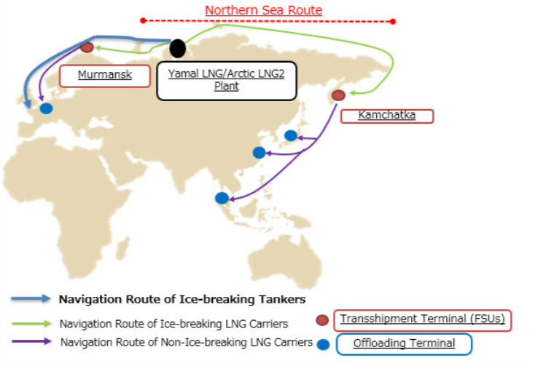

New global order? China, India and Russia
First leg of the route involves the shipment of cargoes on special LNG icebreakers that can cut through ice sheets
Cargo then gets transferred to normal LNG carriers at transshipment terminals for the second leg of the route to customers
Notes:
Criticism on west, accused of “bullying” behavior.

Slide 38
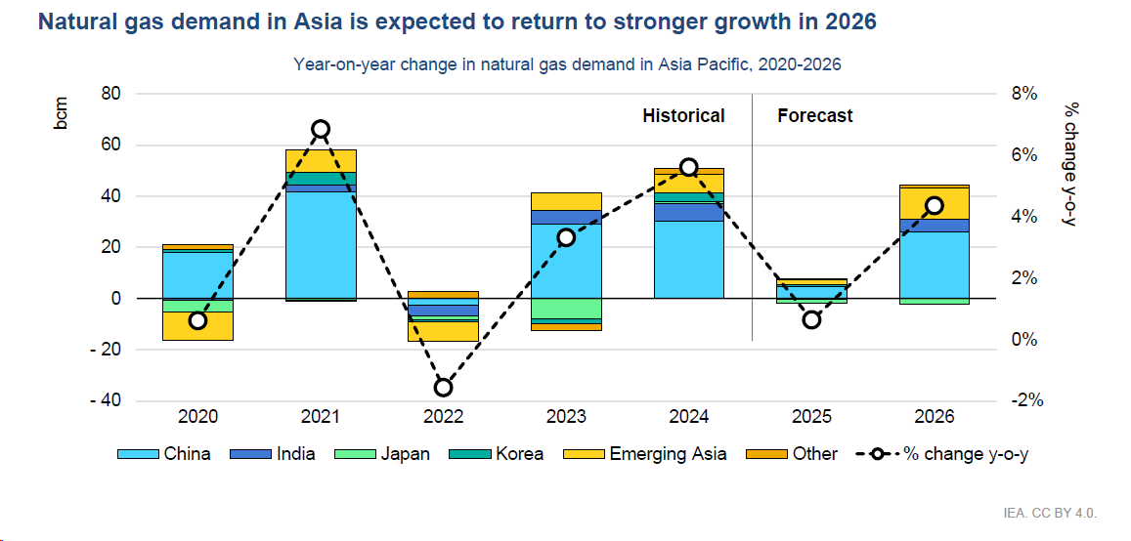
In 2026 demand for natural gas from China is expected to increase significantly
Source: IEA

Slide 39
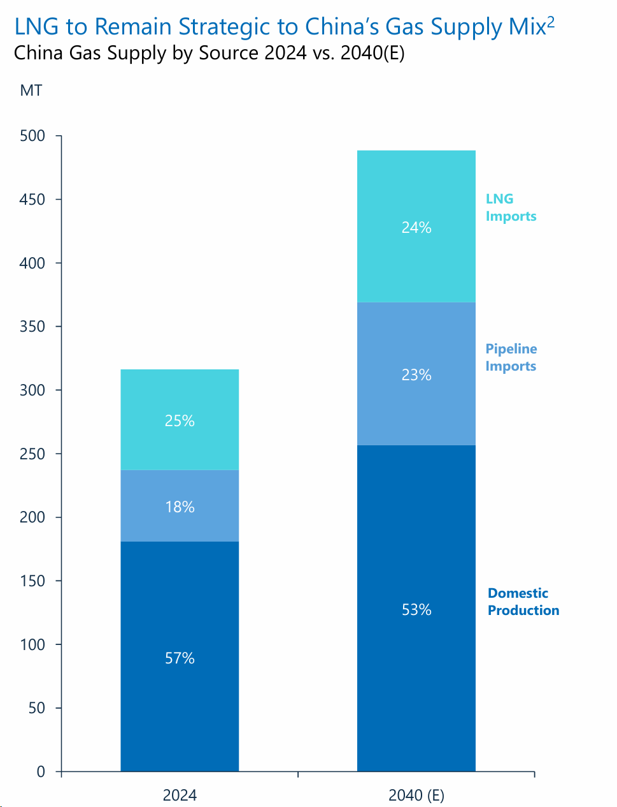
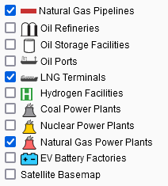
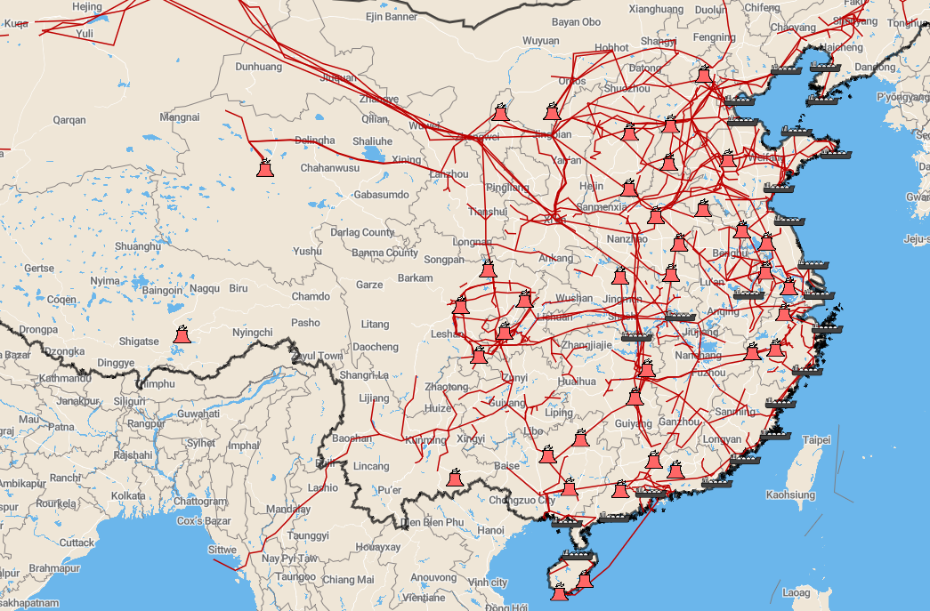
Projection of LNG demand in China by 2040
Source: Cheniere 2025 report
Notes:
Left graph, more than 50% increase in gas demand by 2040
Right graph, the infrastructure is ready.
So where is all this extra supply coming from?
Next slide

Slide 40
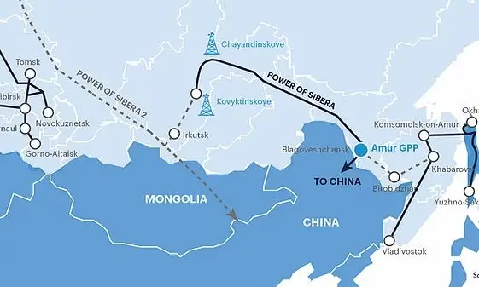
Plans for Power of Siberia 2
Background
Plans for Power of Siberia 2 have been existing since 2013
Initial route via Altai seems to be abandoned as it passes through unstable region of Xinjiang
Implications new proposed route
55 BCM pipeline new proposed route goes through Mongolia and lands close to gas demand centers such as Beijing
Would link East and West Siberian gas fields in Russia’s gas grid, gas initially destined to Europe could flow towards China
Current status
Feasibility study ongoing, no recent breakthrough in China/Russia negotiations
No FID in place
Source: Ponars Eurasia; The Diplomat

Slide 41
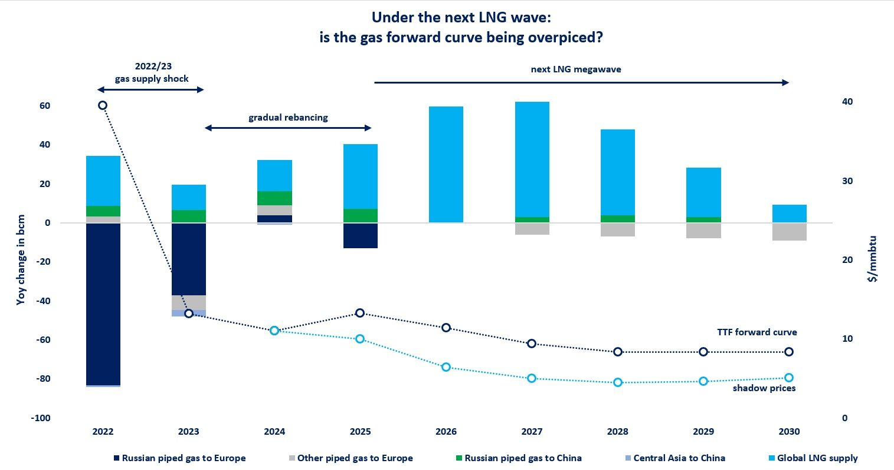
IEA’s shadow EU gas prices are well below current forward prices
IEA expects lower prices in well-supplied LNG market thanks to the upcoming supply “Mega wave”
Shadow prices of IEA are in the range of 15-22 EUR/MWh in 2027-2030 period
Source: International Energy Agency (IEA)

Slide 42
Recent trends in the energy markets
Heading into winter 2025/2026
Long term outlook
ETS 1 & ETS 2

Slide 43
Emission trading system for large industry (ETS)
Goal
Reduce emissions in energy and large manufacturing industry by -62%. This is down from -43% due to Fit-for-55 package.
Timing
Started in 2005
Currently in the first 5-year of the 4th trading period (2021-2030)
Principle
Additional cost for the GHG emissions from the combustion of fossil fuels for
10,000 installations in the energy sector and manufacturing industry
Sites with a combined installed thermal capacity >20 MW of units >3 MW
Aviation
Maritime shipping gradually between 2024 and 2027
Municipal waste incineration from 2028 onwards with possible derogations until 2030 and subject to an EU impact assessment by 2026
Cap and trade system
Maximum emission allowances available (cap)
Allowances auctioned and traded (trade)
Demand and supply set the price for emission allowances (CO₂-price)

Slide 44
Emission trading system for large industry (ETS)
Allowances
Each year, participants must surrender a number of certificates in line with their emissions
Depending on the industry, participants receive free allowances based on a benchmark (product specific, heat, fuel) with technological developments
Industries in risk of carbon leakage receive 100% allowances, others 30%
Industries in the carbon border adjustment mechanism (CBAM) see their free allowances gradually being replaced by a carbon border tax (cement, iron and steel, aluminium, fertilizers, electricity, and hydrogen)
Certificates can be bought on the CO₂-market
Unused certificates are stored in an ETS-register
The quantity of allowances will decrease annually. By 2039, there will be no more allowances issued.
2021-2023: -2,2% per year
2024-2027: -4,3% per year
2028-…: -4,4% per year
One-off reduction in 2024: -90 Mt
One-off reduction in 2026: -27 Mt

Slide 45
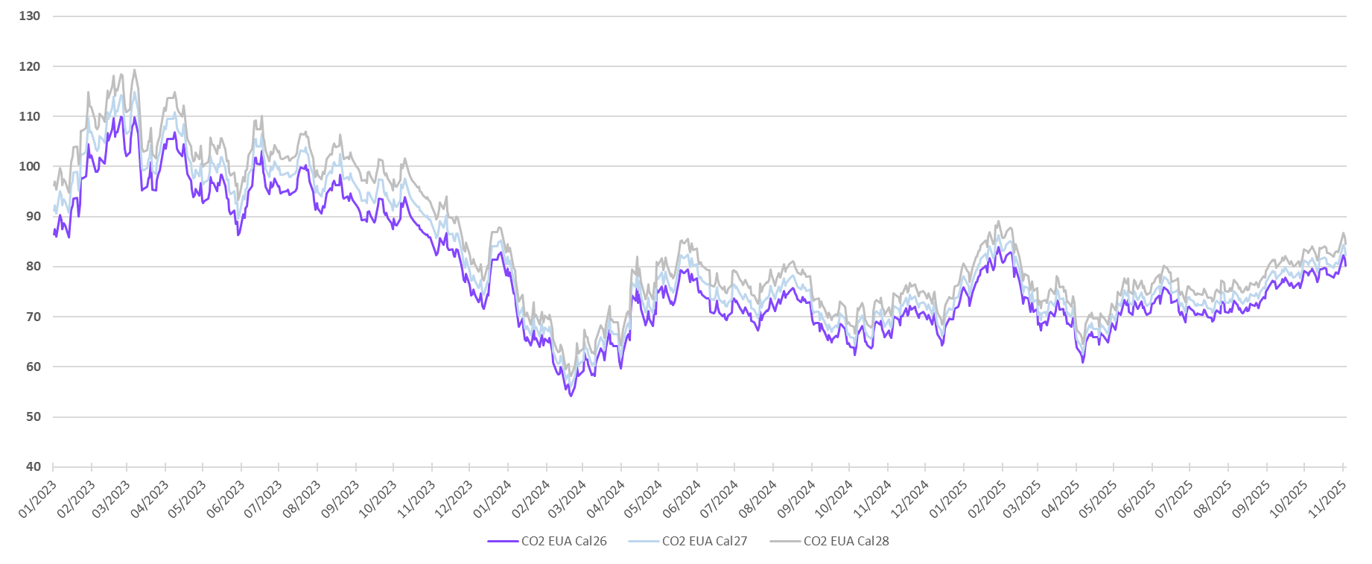
CO2 price evolutions
EUR per Tonne; daily prices of CO2 for CAL26, CAL27 and CAL28

Slide 46
No structural decrease in EUA prices after compliance deadline
Normalized EUA price levels; 100 = EUA price on the annual ETS compliance deadline for EUA surrendering (for each year the normalization was repeated)
X axis shows trading days before and after compliance deadline (which is day 0); Y axis shows normalized EUA prices with compliance deadline price set at 100
Individual years breakdown
Average of 2018-2024 period
Day 0 = Annual ETS compliance deadline for EUA surrendering
Day 0 = Annual ETS compliance deadline for EUA surrendering
15 trading days leading up to deadline
15 trading days after deadline
15 trading days leading up to deadline
15 trading days after deadline
No structural declining trend in EUA prices after compliance deadline has passed:
Average 2018-24 data indicate an increase of 5% in the 15 trading days after the deadline (note: overall price trend in 2018-24 was also positive, possibly amplifying this effect)
Only in 2 of the 6 years analyzed, there was a price drop in the 15 trading days after the deadline (maximum price drop was 5%)

Slide 47
Correlation between EUA prices and positions by investment funds
EUR/Ton;
EUA price
Mt; Long and Short EUA positions by investment funds
Note: Compliance buyers includes also commercial enterprises
Source: EU Commission data, ICE, EEX

Slide 48
Latest CO₂ price projections in EU ETS
EUR/Ton EUAs; Latest forecast available of each source as of Oct 2025

Slide 49
EUA market is expected to change to annual undersupply situation
Mton EUAs
Between 2026 and 2027 ETS EUA market is expected to move from oversupply to undersupply
At the end of 2024, TNAC (Total Number of Allowances in circulation) was 1.148 Mton:
Driven by accumulated EUAs during historical oversupply years
Most of these EUAs are on balances of power and industry enterprises, who are likely to use them for future compliance (unlikely to sell the majority of them)
Even with a higher number of EUAs in circulations, market tightness is possible
Source: LSEG, SEB

Slide 50
Recent trends in the energy markets
Heading into winter 2025/2026
Long term outlook
ETS 1 & ETS 2

Slide 51
Emission trading system for road transport, buildings, additional sectors
Goal
Reduce emissions in road transport, buildings, and additional sectors by -42% by 2030 compared to 2005
Principle
Use of fossil fuels for combustion in
Road transport
Buildings
Additional sectors
In principle, alle sectors except agriculture, fishery, and mining industry
For sites covered by ETS: all stationary installations covered by the same environmental permit, are exempted
Member states have the freedom to
Set up their own carbon credit system until the end of 2030 if the price for carbon is equal or higher than the price of ETS2 allowance
Expand additional sectors covered by ETS2 after approval by the EU Commission, e.g. Netherlands, Austria
Combustion fuels:
(unleaded) gasoline, gasoil, paraffin, LPG, natural gas, fuel oil, coal, coke
Any other product used as motor or heating fuel
Not including peat, charcoal, waste, solid biomass
The sustainable nature of biomass must be proven by a Proof of Sustainability from a voluntary programme (ISCC, RedCert...)

Slide 52
Emission trading system for road transport, buildings, additional sectors
Start
Starting in 2028
With the option of 1-year delay if energy prices are extremely high in 2026
If any of these conditions are met:
Average TTF gas price for Jan-Jun 2026 is higher than the average TTF gas price in Feb-Mar 2022 (i.e. 105.1 €/MWh)
Average Brent crude oil price for Jan-Jun 2026 is higher than twice the Brent crude oil price for 2021-2025
Regulated entities
Through regulated entities
These are the distributors and sellers of combustion fuels
Require a permit (2024)
Monitoring, reporting and verifying emissions from combustion fuels (2025)
Surrender of allowances (2029)
Charge customers for the additional cost of emissions allowances (2028)

Slide 53
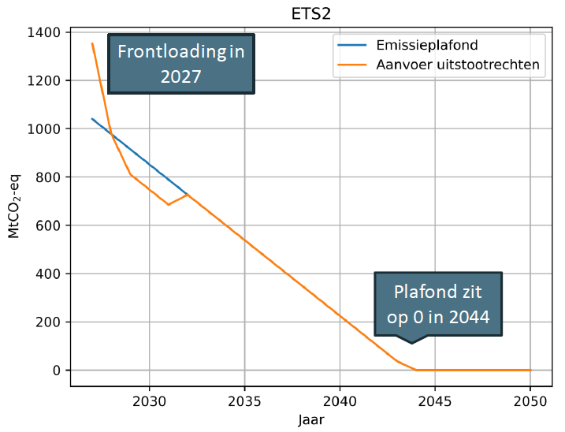
Emission trading system for road transport, buildings, additional sectors
Cost
Cap & trade system:
Cap: maximum number of allowances available
Trade: allowances can be obtained and traded (via an auction)
1 allowance = 1 tonne of CO₂
By 2028, 130% of the volume of allowances will be auctioned to give the market a head start with sufficient allowances
150 million allowances will be issued for the Social Climate Fund
The rest will be issued by the member states
The volume of allowances will decrease annually with a linear reduction factor of 5.38%
Revenues
Revenues from the auction will be used for
Social Climate Fund (to support poor households across Europe)
Member states to launch their own initiatives around measures for decarbonisation of heating/cooling of buildings, roll-out of zero-emission cars and their own social climate plan

Slide 54
Emission trading system for road transport, buildings, additional sectors
Allowances
Price is strived to be kept under control until 2031
Frontloading in 2028 would initially limit price impact
Strive value of 45 €/tonne CO₂ (excluding inflation; price could reach 55 €/tonne CO₂ by 2030)
Measures to keep price under control will come from the market stability reserve:
If price exceeds 45 €/tonne CO₂ (excluding inflation) for 2 consecutive months → release of 20 Mln allowances
If the average price of 3 consecutive months is 1.5 times higher than the average price of the previous 6 months → release of 50 Mln allowances
If the average price of three consecutive months is three times higher than the average price of the preceding 6 months → release of 150 Mln allowances
Impact on consumers' bill depending on emission factor (tonne CO₂ per MWh fuel)
Natural gas (0.182 tonnes CO₂/MWh) Gasoline (0.251 tonnes CO₂/MWh – 9.6 kWh/l)
10 €/MWh = 1 ct€/kWh
ETS2-price (€/tonne CO₂) | 25 | 30 | 35 | 40 | 45 | 50 | 55 | 60 | 65 | 70 | 75 | 80 | 85 | 90 | 95 | 100
Natural gas (€/MWh) | 4,6 | 5,5 | 6,4 | 7,3 | 8,2 | 9,1 | 10,0 | 10,9 | 11,8 | 12,7 | 13,7 | 14,6 | 15,5 | 16,4 | 17,3 | 18,2
Gasoline (ct€/l) | 6,0 | 7,2 | 8,4 | 9,6 | 10,8 | 12,0 | 13,3 | 14,5 | 15,7 | 16,9 | 18,1 | 19,3 | 20,5 | 21,7 | 22,9 | 24,1

Slide 55
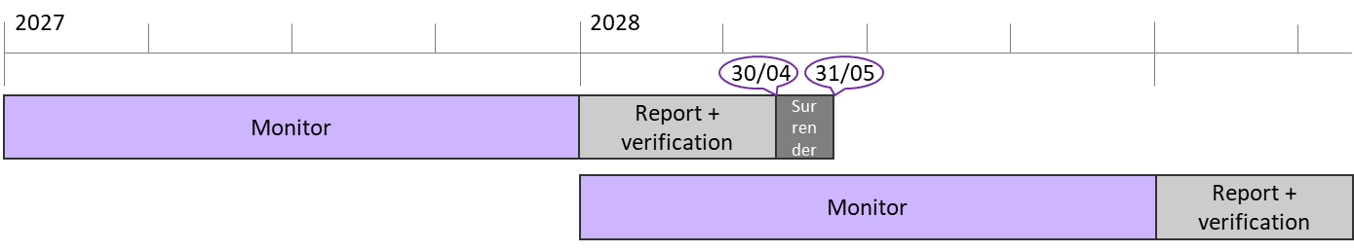
Emission trading system for road transport, buildings, additional sectors
Invoices
Fuel suppliers will pass on additional costs to the user
ETS2 emission allowances
Administration for monitoring, reporting, verification and billing
It is not yet known how fuel suppliers will handle the costs
Supplier must surrender allowances in year Y+1 while costs will be passed on in year Y
Options for suppliers
Extra monthly cost included in a contract as a mark-up for ETS2 costs
Based on a monthly or quarterly average spot price, or on a forward price
Credit note at the beginning of the year on last year's costs
Other...
Strategies to manage costs
Take into account in contract negotiations for fuel contracts from 2027 onwards
Compare price formulas of different suppliers together with commodity price
For consumers who want to take own responsibility: active market trading of allowances and transfer to supplier
After agreement with supplier and setting up an account (trading or custodial)
2028
2029

Slide 56
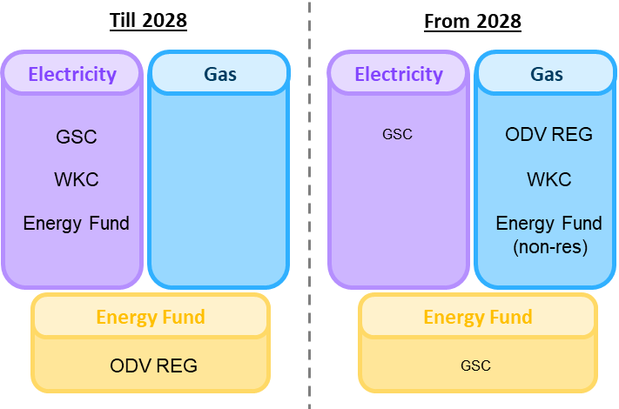
Context: Markets and regulation
Tighter ETS and launch of ETS-2
Power to natural gas tax shift
Starting in 2027 => delayed to 2028
Additional cost on combustion fuels for road transport, buildings, and additional sectors
Distributors and sellers of combustion fuels are regulated entities (monitoring, reporting, verification, surrender)
Pass-through of costs to the user
Cap and trade system
Intention to keep price under control until 2030
Strive value 45 €/tonne CO₂ + inflation (58 €/tonne CO₂ by 2027)
With measures from the market stability reserve
Analysts foresee a potential higher price (60-80 €/tonne CO₂)
Tax shift proposed by Flemish Government in Flemish Energy and Climate Plan
Shift of 326 M€ from electricity to fossil fuels
The necessary amendments will be drawn up during 2026 and will take effect in 2028
Reduce electricity cost further with 180 M€ from ETS2-revenues
Tax shift on federal level can have a larger impact
ETS2-price (€/tonne CO₂) | 40 | 50 | 60 | 70 | 80
Natural gas (€/MWh) | 7,3 | 9,1 | 10,9 | 12,7 | 14,6
Gasoline (ct€/l) | 9,6 | 12,0 | 14,5 | 16,9 | 19,3
Natural gas (0,182 tonnes CO₂/MWh)
Gasoline (0,251 tonnes CO₂/MWh – 9,6 kWh/l)

Slide 57
THANK YOU FOR YOUR ATTENTION
Yannick Rotsaert
Yannick.rotsaert@power-pulse.be
+32 472 708 406

